Slide 1


Green Pace
Security Policy Presentation
Developer: Kyle Blan
Best Practices in Secure Coding: Adhering to Coding Standards
Notes:
Welcome everyone, and thank you for tuning into this presenation that is all about best practices in secure coding, and adhering to coding standards.

Slide 2

OVERVIEW: DEFENSE IN DEPTH
Adhering to coding standards not only fosters consistency and maintainability in codebases but also plays a crucial role in mitigating security risks. By implementing these standards, we establish a framework for secure coding practices that permeates throughout our development processes.
Notes:
In this presentation, we'll explore the importance of secure coding standards and their role in establishing a robust foundation for secure software development. This is further illustrated by the defense in depth diagram. By implementing this policy, we establish a framework for secure coding practices that permeates throughout our development processes.

Slide 3
THREATS MATRIX
XSS attacks involve injecting malicious scripts into web pages viewed by other users. They are highly likely due to their prevalence in web applications.
Authentication bypass vulnerabilities allow attackers to gain unauthorized access to systems or resources without providing valid credentials.
SQL Injection attacks are prevalent and pose a significant threat to databases and sensitive data.
Likely Cross-Site Scripting (XSS) Authentication Bypass | Priority Cross-Site Request Forgery (CSRF) SQL Injection
Low priority Information Leakage Denial of Service (DoS) | Unlikely XML External Entity (XXE) Insecure Deserialization Insecure Direct Object References (IDOR)
Notes:
Now, let's delve into our threat matrix, a vital tool for identifying and prioritizing potential security threats. Our threat matrix categorizes security threats into four main categories: Likely, Priority, Low Priority, and Unlikely. Each threat is evaluated based on its likelihood and priority level, allowing us to focus our security efforts on the most significant risks.

Slide 4
10 PRINCIPLES
Validate Input Data: Ensuring that input data is validated and sanitized is paramount to prevent injection attacks and other forms of exploitation. [INT-050-CPP], [STR-051-CPP], [ERR-050-CPP]
Practice Defense in Depth: Implementing multiple layers of security controls helps mitigate the impact of security breaches and provides redundancy in defense mechanisms. [DCL-055-CPP], [EXP-052-CPP], [STR-050-CPP], [FIO-050-CPP], [FIO-051-CPP], [ERR-050-CPP]
Adhere to the Principle of Least Privilege: Limiting access rights for users, processes, and systems to the minimum levels necessary reduces the potential impact of security breaches. [DCL-055-CPP],
Keep It Simple: Simplicity in design and implementation reduces the attack surface and enhances code maintainability, making it easier to identify and address security vulnerabilities. [DCL-051-CPP], [EXP-052-CPP], [EXP-058-CPP], [INT-050-CPP], [STR-050-CPP], [STR-051-CPP], [FIO-050-CPP], [FIO-051-CPP], [ERR-050-CPP]
Use Effective Quality Assurance Techniques: Rigorous testing and code review processes help identify and rectify security vulnerabilities before they can be exploited in production environments. [DCL-051-CPP], [DCL-055-CPP], [EXP-052-CPP], [EXP-058-CPP], [INT-050-CPP], [STR-050-CPP], [FIO-050-CPP], [FIO-051-CPP],
Secure Authentication and Authorization: Implementing robust authentication and authorization mechanisms ensures that only authorized users can access sensitive resources and functionalities.
Secure Data Storage: Safeguarding stored data with encryption and access controls protects against unauthorized access and data breaches. [STR-050-CPP], [STR-051-CPP]
Secure Error Handling: Proper error handling mechanisms prevent the disclosure of sensitive information and help maintain the integrity and availability of the application. [INT-050-CPP], [STR-051-CPP],
Secure Communication: Encrypting data transmission and using secure communication protocols protect against eavesdropping and tampering during transit. [FIO-050-CPP]
Secure Third-Party Integration: Vetting and securing third-party services and components mitigate the risk of supply chain attacks and ensure the overall security of the software ecosystem.
Notes:
In this section, we'll explore the ten principles of secure coding and their alignment with our adopted standards. As you can see, our policy includes a heavy emphasis on software methodology and quality assurance practice.

Slide 5
CODING STANDARDS
DCL51-CPP - Do not declare or define a reserved identifier.
DCL55-CPP - Avoid information leakage when passing a class object across a trust boundary.
EXP52-CPP - Do not rely on side effects in unevaluated operands.
EXP58-CPP - Pass an object of the correct type to va_start.
INT50-CPP - Do not cast to an out-of-range enumeration value.
STR50-CPP - Guarantee that storage for strings has sufficient space for character data and the null terminator.
STR51-CPP - Do not attempt to create a std::string from a null pointer.
FIO50-CPP - Do not alternately input and output from a file stream without an intervening positioning call.
FIO51-CPP - Close files when they are no longer needed.
ERR50-CPP - Do not abruptly terminate the program.
Notes:
Here we will explore the ten adopted standards that form the backbone of our secure coding practices. These standards provide guidelines and best practices for writing secure, resilient code.

Slide 6
ENCRYPTION POLICIES
Data Encryption at Rest:
This policy mandates that all sensitive data stored on our systems must be encrypted. By encrypting data at rest, even if physical or virtual drives are compromised, the data they contain remains unreadable to unauthorized individuals.
In practice, this policy may involve implementing disk encryption technologies such as BitLocker or FileVault, which encrypt entire volumes or drives, or utilizing database-level encryption for data stored within databases. These encryption measures help safeguard sensitive information and protect against data breaches.
Data Encryption in Transit:
This policy requires that all data sent over networks, whether internal or external, must be encrypted. Encrypting data in transit prevents unauthorized interception and access to sensitive information during transmission.
In practice, this policy could involve using secure communication protocols such as HTTPS for web traffic or Transport Layer Security (TLS) for other types of network traffic. These encryption protocols ensure the confidentiality and integrity of data as it traverses network connections.
Data Encryption in Use:
This policy stipulates that data must be encrypted even when being used or processed to maintain security in scenarios where the system processing the data may be compromised.
In practice, this policy could involve employing advanced encryption techniques such as homomorphic encryption, which allows computations to be performed on encrypted data without decrypting it first. Homomorphic encryption ensures that sensitive data remains secure throughout processing operations, reducing the risk of data exposure or compromise.
Notes:
Now, let's discuss our encryption policies, which play a crucial role in protecting sensitive data from unauthorized access and ensuring its confidentiality and integrity. It is important to note that by implementing these encryption policies, we can strengthen our data protection measures, mitigate the risk of unauthorized access, and ensure compliance with regulatory requirements.

Slide 7
TRIPLE-A POLICIES
Authentication:
This policy requires users to prove their identity before accessing our systems. By enforcing authentication, only legitimate users can log in, reducing the risk of unauthorized access and protecting sensitive information.
In practice, authentication methods such as usernames and passwords, two-factor authentication (2FA), or biometric authentication may be employed. These methods validate users' identities and ensure that only authorized individuals can access system resources.
Authorization:
This policy dictates what resources and services a user can access once they are authenticated. It ensures that users have access only to the resources necessary for their role or job function, reducing the risk of unauthorized access and maintaining the principle of least privilege.
In practice, authorization involves setting user roles and permissions based on job responsibilities or organizational hierarchy. Users are granted access to specific resources, functionalities, or data based on their assigned roles, preventing unauthorized access to sensitive information.
Accounting:
This policy mandates the tracking of user activities on our systems. By logging user actions, organizations can create an audit trail that records user interactions with system resources and services.
In practice, accounting involves logging various user activities such as logins, database changes, new user additions, changes in access levels, and files accessed by users. This audit trail serves multiple purposes, including troubleshooting, identifying misuse or security incidents, and ensuring compliance with regulatory requirements.
Notes:
Now, let's delve into the core of our cybersecurity strategy—the Triple A policies of Authentication, Authorization, and Accounting. These policies form the backbone of our defense mechanisms, ensuring the integrity, confidentiality, and availability of our organization's resources. In essence, the Triple A policies serve as the guardians of our digital fortress, fortifying our defenses, and preserving the trust and confidence of our stakeholders.

Slide 8
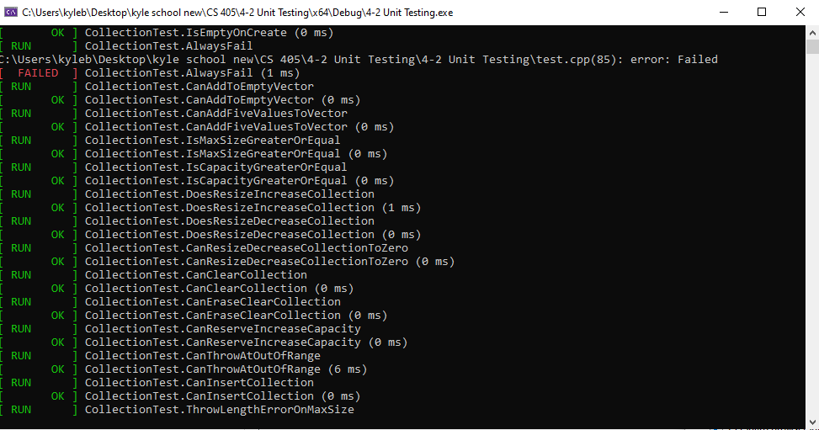
Unit Testing
Unit Testing Results
Notes:
Here we have our Unit testing results, as you can see the testing was entirely successful.

Slide 9
Unit Testing
CollectionTest.AlwaysFail
Test Description: This test case is designed to intentionally fail.
Result: The test failed with an error.
Duration: 2 ms
Notes:
We have our first test case that was simply labeled “Always Fail,” and is designed, of course, to intentionally fail.

Slide 10
Unit Testing
CollectionTest.CanAddToEmptyVector
Test Description: Verifies if items can be added to an empty vector.
Result: The test passed successfully.
Duration: 0 ms
Notes:
More information about our unit testing provided here, verifying that data can be added to a vector.

Slide 11
Unit Testing
CollectionTest.CanAddFiveValuesToVector
Test Description: Checks if five values can be added to a vector.
Result: The test passed successfully.
Duration: 0 ms
Notes:
Unit testing is continued here, further information about a specific case, where we add 5 values to a vector.

Slide 12
Unit Testing
CollectionTest.CanThrowAtOutOfRange
Test Description: Tests if an out-of-range exception is thrown.
Result: The test passed successfully.
Duration: 10 ms
Notes:
Finally, we have a test case here that shows we can throw proper exceptions when a value is out of range.

Slide 13

AUTOMATION SUMMARY
Notes:
DevSecOps aims to integrate security throughout the software development lifecycle, ensuring secure code delivery, and in this case integrating security practices throughout the software development lifecycle (SDLC).

Slide 14
TOOLS
The DevSecOps pipeline is an extension of the traditional CI/CD (Continuous Integration/Continuous Deployment) pipeline, integrating security practices throughout the software development lifecycle (SDLC). Let’s break it down:
Source Code Management (SCM): This is where developers manage and track changes to the source code using version control systems like Git. It ensures collaboration and version control.
Continuous Integration (CI): In this stage, code changes are automatically integrated into a shared repository. Automated build and testing processes follow, ensuring that code quality is maintained.
Static Analysis: Static code analysis tools scan the codebase for vulnerabilities, coding errors, and security issues. They identify potential weaknesses early in the development process.
Threat Intelligence: DevSecOps pipelines incorporate threat intelligence feeds to stay updated on emerging threats. This helps in proactively addressing security risks.
Policy Enforcement: Automated policy checks ensure that code adheres to security policies and standards. If any violations are detected, the pipeline can halt the deployment process.
Dynamic Application Security Testing (DAST): DAST tools assess the application during runtime by simulating attacks. They identify vulnerabilities that might not be apparent during static analysis.
Container Security: For applications deployed in containers (e.g., Docker), container security tools scan images for vulnerabilities and misconfigurations.
Compliance Validation: DevSecOps pipelines validate compliance with industry standards (e.g., GDPR, HIPAA) and internal policies. Automated checks ensure adherence.
Infrastructure as Code (IaC) Security: If you use IaC tools like Terraform or CloudFormation, security checks are performed on infrastructure definitions to prevent misconfigurations.
Secrets Management: Tools manage secrets (API keys, passwords) securely, preventing accidental exposure in code repositories.
Monitoring and Feedback: Continuous monitoring of production environments provides feedback to improve security. Tools like intrusion detection systems (IDS) and log analysis help detect anomalies.
Notes:
Next we have a tool summary showing how different toolbox items help to achieve a sager SDLC. Our DevSecOps pipeline is made up of component parts, each of equal importance.

Slide 15
RISKS AND BENEFITS
Problem: Lack of adherence to coding standards may result in inconsistent code quality, increased vulnerability to security threats, and difficulties in collaboration and maintenance.
Solution: Implementing coding standards provides guidelines and best practices for writing secure, maintainable, and efficient code.
Risks: Delaying the implementation of coding standards may lead to continued exposure to security risks, increased technical debt, and challenges in code review and integration.
Benefits: Acting now to implement coding standards can result in improved code quality, reduced vulnerabilities, enhanced team collaboration, and easier code maintenance.
Notes:
In summary, we've identified a critical problem: the lack of adherence to coding standards. This issue can manifest in various ways, including inconsistent code quality, increased vulnerability to security threats, and difficulties in collaboration and maintenance. Fortunately, we have a solution at hand: implementing coding standards. By adopting guidelines and best practices for writing secure, maintainable, and efficient code, we can address these challenges head-on.

Slide 16
RECOMMENDATIONS
This policy does not implement a full suite of coding standards that would be necessary to adequately protect our systems and data. Instead we were directed to select only 10 standards. Recommend implementing a full compliment of coding standards to mitigate further security considerations.
Notes:
As for recommendations, our policy covers only a narrow scope of security sensitive topics. To ensure a secure pipeline, we must implement a full complement of coding standards to govern all aspects of the SDLC.

Slide 17
CONCLUSIONS
In order to prevent future security problems, the following should be considered for implementation
Code Review and Testing Standards: Implementing standards for code review and testing ensures that software is thoroughly reviewed and tested for security vulnerabilities, logic errors, and other issues before deployment, reducing the likelihood of bugs and vulnerabilities in production.
Access Control Standards: Establishing access control standards helps enforce the principle of least privilege, ensuring that users have access only to the resources and functionalities necessary for their role or job function, minimizing the risk of unauthorized access and data exposure.
Logging and Monitoring Standards: Implementing logging and monitoring standards enables organizations to track and analyze user activities, system events, and security incidents in real-time, facilitating early detection and response to potential threats and breaches.
Notes:
First and foremost, Code Review and Testing Standards play a vital role. These standards ensure that software undergoes thorough review and testing for security vulnerabilities, logic errors, and other issues before deployment. By doing so, the likelihood of bugs and vulnerabilities in production is significantly reduced. Next, Access Control Standards are essential. These standards enforce the principle of least privilege, ensuring that users are granted access only to the resources and functionalities necessary for their role or job function. This minimizes the risk of unauthorized access and data exposure, bolstering overall security posture. Finally, Logging and Monitoring Standards are indispensable. By implementing these standards, organizations can track and analyze user activities, system events, and security incidents in real-time. This enables early detection and response to potential threats and breaches, enhancing the organization's ability to safeguard its assets and infrastructure.

Slide 18
REFERENCES
Sei cert C++ coding standard. SEI CERT C++ Coding Standard - SEI CERT C++ Coding Standard - Confluence. (n.d.). https://wiki.sei.cmu.edu/confluence/pages/viewpage.action?pageId=88046682
Notes:
Thank you! If you have any questions about the presentation, please feel free to drop a comment down below.

